Slide 1
Introduction to Responsive Web Design

Slide 2
Objectives
In this session, you will learn to:
  Understand building blocks and the architecture of RWD
  Identify the development environment

Slide 3
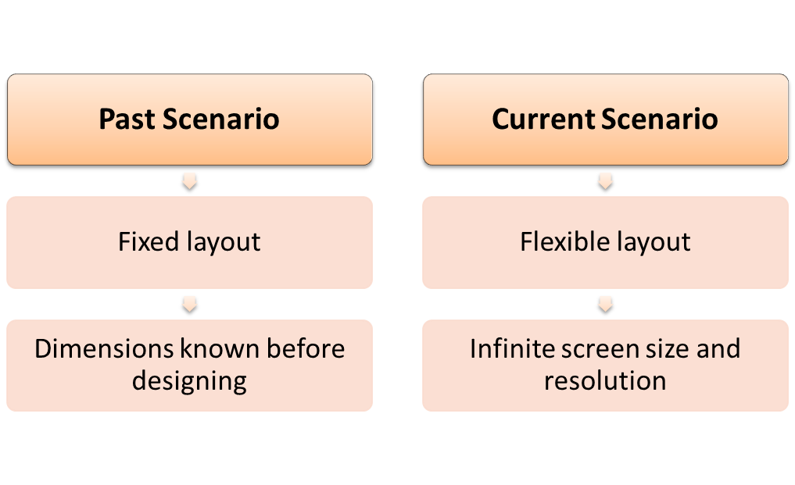
Understanding Building Blocks and the Architecture of RWD
In the past, designers focused on the layout before designing for the Web.
With the advent of devices, a website can be viewed on a high definition TV, smartphone, or a simple desktop.
RWD automatically adjusts to different screens and resolutions.

Slide 4
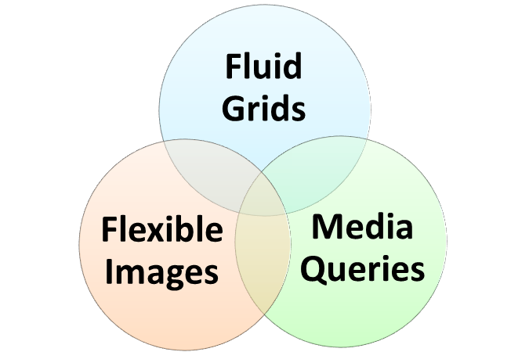
Building Blocks of RWD
To create a flexible design of a website, RWD relies on the following three building blocks.
By combining the three building blocks, powerful and responsive Web pages are created that are displayed well on a variety of devices.

Slide 5
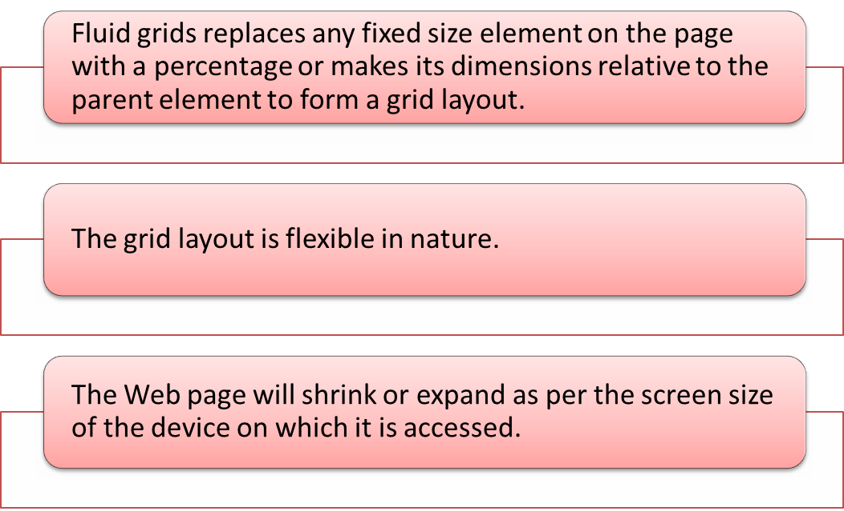
Building Blocks of RWD (Contd.)
Fluid grids

Slide 6
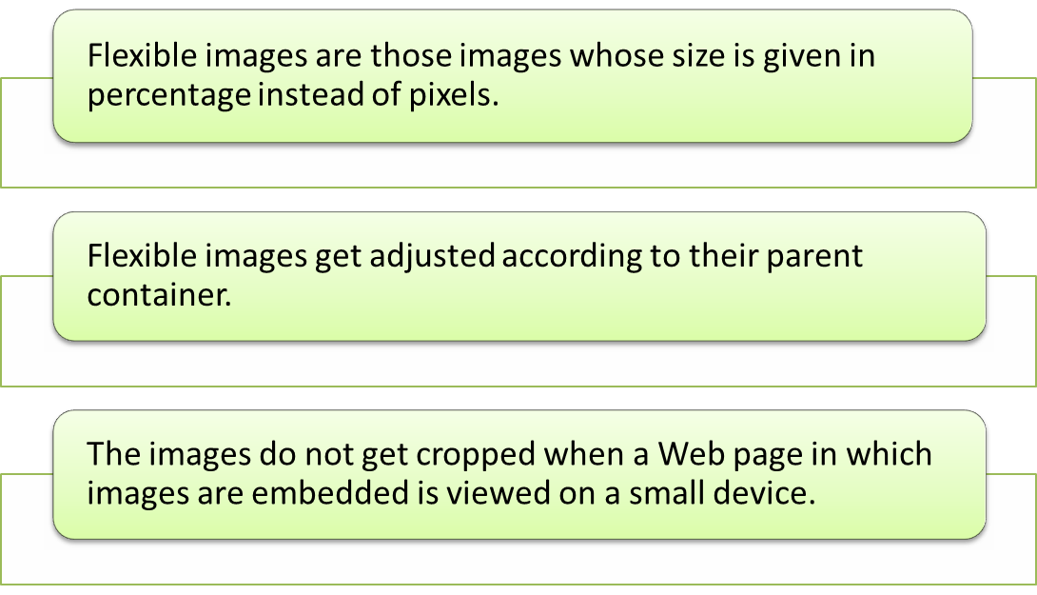
Building Blocks of RWD (Contd.)
Flexible images

Slide 7
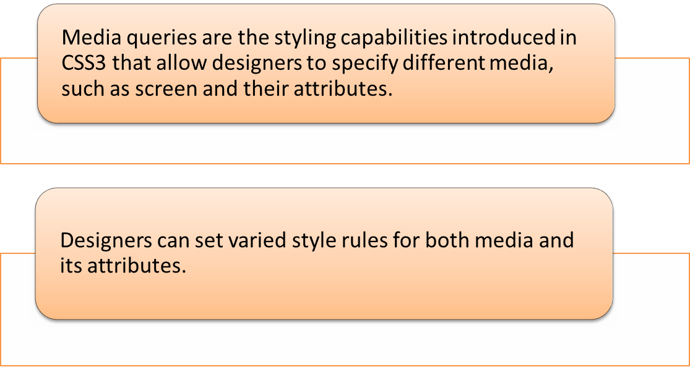
Building Blocks of RWD (Contd.)
Media queries

Slide 8
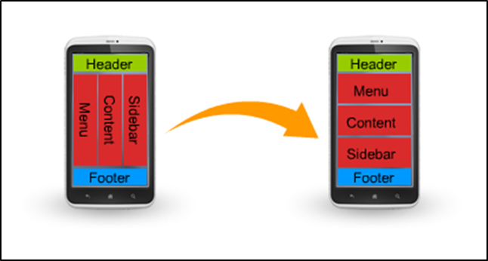
Building Blocks of RWD (Contd.)
A media query overrides the default styling and applies the specified style for a screen.
A media query can change the display of a Web page to a single-column layout instead of a three-column layout.

Slide 9
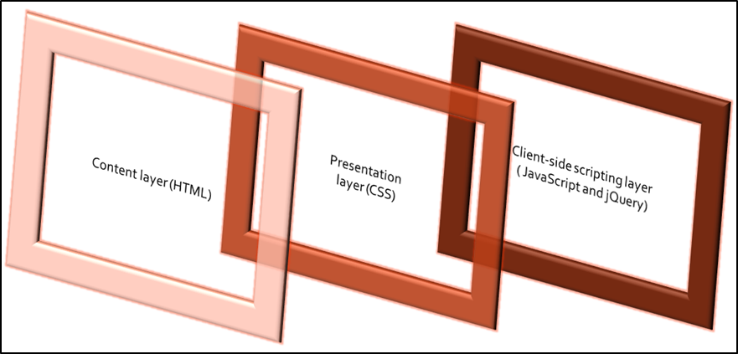
Architecture of RWD
The architecture of RWD consists of the following layers or stratums:
  Content layer that comprises rich semantic Hyper Text Markup Language (HTML)
  Presentation layer that comprises CSS for styling
  Client-side scripting layer that comprises JavaScript or jQuery
Implementation of the three layers helps in designing Web pages.

Slide 10
Architecture of RWD (Contd.)
A content layer consists of the rich semantic HTML language that helps to specify the way to display text and graphics on a Web page.
HTML5 provides semantic tags to define the structure of a website.
Examples of good semantic HTML markup are:
  Using the new elements introduced in HTML5, such as:
    <nav>
    <footer>
    <article>
    <aside>
  The preceding elements replace generic blocks, such as <div> and inline <span>.
  Using the new multimedia tags, such as <audio> and <video> , replaces the generic <object> tag.

Slide 11
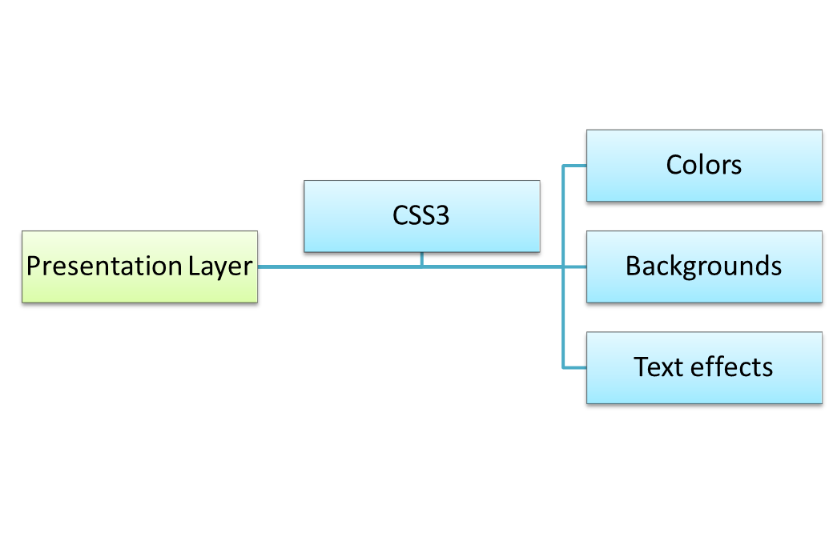
Architecture of RWD (Contd.)
A presentation layer consists of CSS3, which is used with HTML5 to enhance the look and feel of a Web page.
CSS3 also helps to specify the media types.

Slide 12
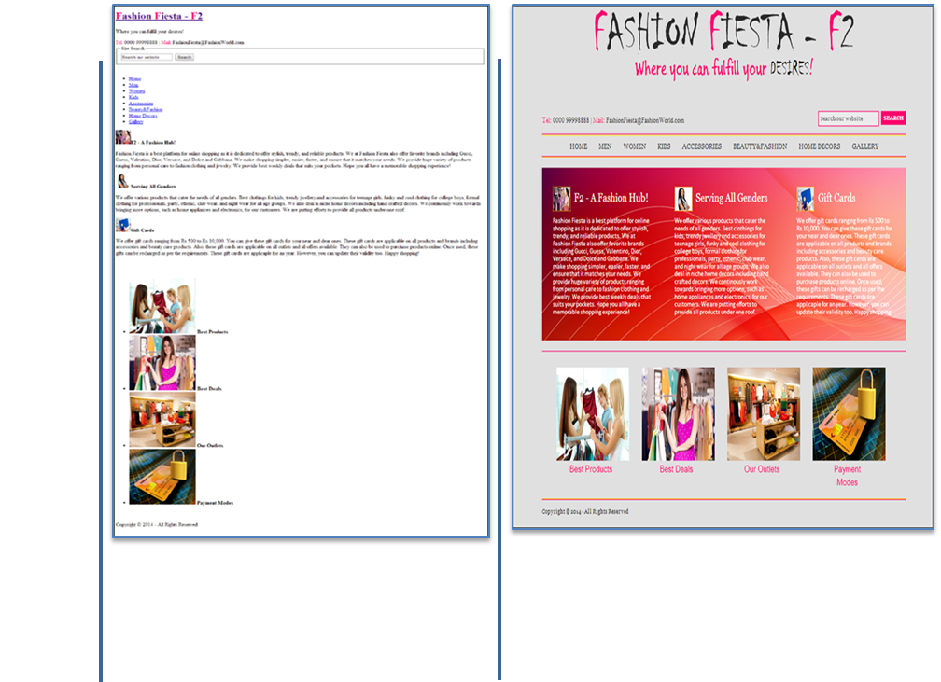
Architecture of RWD (Contd.)
There is a clear difference in the look and feel of a Web page created by using HTML5 only and a Web page enhanced by CSS3.

Slide 13
Architecture of RWD (Contd.)
A client-side scripting layer, the third layer, consists of JavaScript or jQuery.
JavaScript or jQuery enables designers to add interactivity to a Web page.
jQuery eliminates the need for writing large lines of JavaScript code.
Designers can easily perform various tasks, such as:
  Adding animations and visual effects to a Web page.
  Adding various events, such as the click event or the mouse hover event.

Slide 14
Just a Minute
In the RWD architecture, the _______________ layer comprises the rich semantic Hyper Text Markup Language (HTML).
  Client-side scripting
  Content
  Presentation
An iPhone Simulator

Slide 15
Just a Minute (Contd.)
Answer:
  Content
An iPhone Simulator

Slide 16
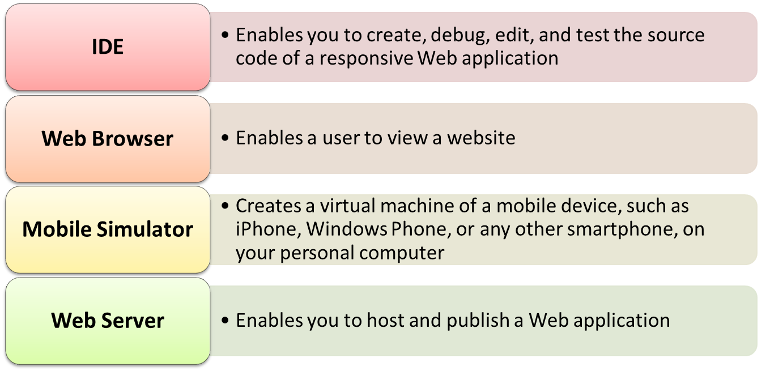
Identifying the Development Environment
A development environment is a collection of tools used to create a program or an application in a given language.
The tools of development environment are.

Slide 17
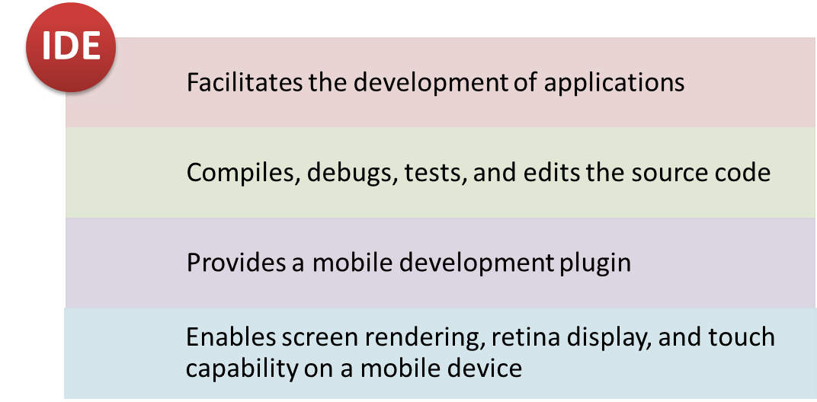
Identifying IDEs
IDEs, such as Dreamweaver, FrontPage, NetBeans, Eclipse, WebMatrix, Twitter Bootstrap, Visual Studio, Mobitest, Codepen, and Edge Inspect, facilitate the development of a website in various ways.

Slide 18
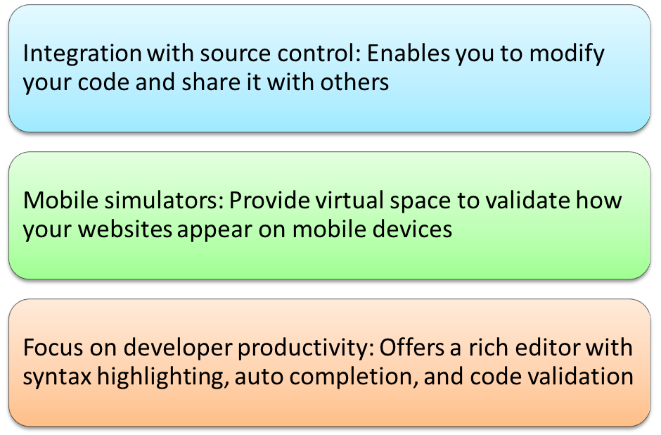
Identifying IDEs (Contd.)
WebMatrix is Microsoft’s new free website development tool to create, edit and publish websites.
It enables you to develop websites using HTML5, CSS, ASP.NET, PHP, and XML.
It provides the following features.

Slide 19
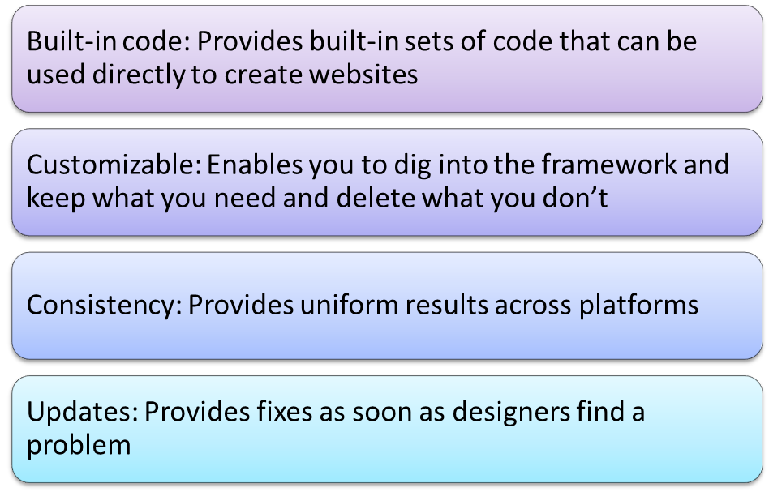
Identifying IDEs (Contd.)
Twitter Bootstrap is one of the sleek, intuitive, and powerful front-end frameworks.
It uses HTML, CSS, and JavaScript for creating websites.
It provides the following features.

Slide 20
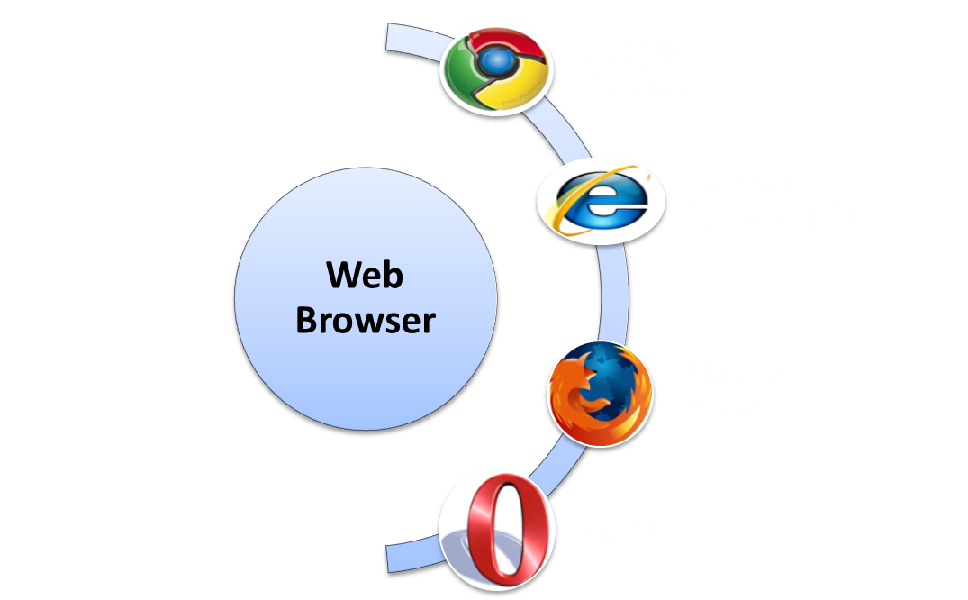
Identifying Web Browser/Mobile Simulator
A Web browser is a software application used for retrieving, presenting, and traversing information resources on the World Wide Web.
Some of the common examples of Web browsers are.

Slide 21
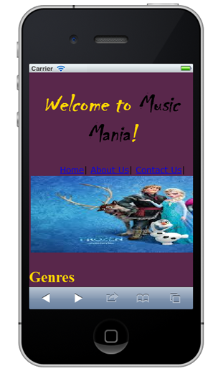
Identifying Web Browser/Mobile Simulator (Contd.)
A mobile simulator:
  Is software that creates a virtual machine of a mobile device on your personal computer.
  Enables you to run a website on an image of different mobile devices and determine how it performs on these devices.
  Enables you to test the website content in real-time devices, locate errors or loopholes, and test the rendering of a website in different devices.
Use the animation, RWD_01_Understanding Development Environment, to understand the concept of development environment.

Slide 22
Just a Minute
_______________ is an open-source IDE that provides a platform for creating the applications primarily in Java.
  Dreamweaver
  WebMatrix
  NetBeans
  Bootstrap

Slide 23
Just a Minute (Contd.)
Answer:
  NetBeans
An iPhone Simulator

Slide 24
Exploring the WebMatrix IDE
Let us explore the WebMatrix IDE.

Slide 25
Activity: Creating a Web Page
You are a Web developer at BuildYourWeb Inc. You have been assigned the task of creating the home page for FoodHub, which is an emerging name in the food business. As part of the customer satisfaction initiative, the management wants to provide various services to its customers at their doorstep. For this, the management wants a website where customers can view the menu and order food to be constructed. You need to create the home page of the website based on the following guidelines:
  It should display the logo of the organization.
  It should display the text, We make your experience a special one!.
  It should display the following information about FoodHub:
  FoodHub is an American chain of restaurants that enables food lovers to come together and enjoy food. It provides online delivery of food items, 24*7. At FoodHub, you will have some of the city’s best destination cafes, bistros, restaurants, fast food, and others under one roof. FoodHub provides its customers a heady combination of surreal surroundings in addition to tongue tickling food of different cuisines. FoodHub is not only the best choice for traditional food at any hour of the day, but also a good place for children to have fun. We provide entertaining facilities, such as puppet shows, for children.
An iPhone Simulator

Slide 26
Activity: Creating a Web Page (Contd.)
  It should display the following cuisines offered by FoodHub:
    American
    Spanish
    Mexican
    Indian
    Chinese
    Mughlai
    Portuguese
    Vietnamese
  It should display the text, Come with your family or friends to cater brilliant tastes!.
  It should display the image of a dish on the right side of the page.
  It should display the images of the following options at the bottom of the page:
    Call Us At
    About Us
    Best Deal
    Recipes
    Menu
    Whats New
    Home
An iPhone Simulator

Slide 27

Activity: Creating a Web Page (Contd.)
  The home page should appear, as shown in the following figure.
Prerequisite: To complete this activity, you need to use the images.zip file.
An iPhone Simulator

Slide 28
Summary
In this session, you learned that:
  To create a flexible design of a website, RWD relies on the following building blocks:
    Fluid grids
    Flexible images
    Media queries
  The architecture of RWD consists of the following layers or stratums:
    Content layer that comprises rich semantic HTML
    Presentation layer that comprises CSS for styling
    Client-side scripting layer that comprises JavaScript or jQuery
  Before creating a responsive website, you need a development environment, which is a collection of tools used to create a program or an application in a given language.
An iPhone Simulator

Slide 29
What’s Next?
After this session, you need to do the following tasks:
  Go through the recorded lecture on the following topic through Cloudscape:
    Identifying Web Designing Techniques
  Perform the following exercises of Chapter 1:
    Exercise 7
    Exercise 8
    Exercise 14
    Exercise 16
    Exercise 20
    Exercise 22
    Exercise 28
  Attend Cycle Test 1

